Slide 1
Organizational Behaviour
Introduction

Slide 2
What is an Organization?
A structured social system consisting of group and individuals working together to meet some agreed on objectives
The core purpose of an organization is the creation of ...
Vision, Missions, and Objectives

Slide 3
Vision :
To establish world class platform for creation of knowledge through quality research and its dissemination through technologically enabled teaching - learning pedagogy in the field of science, technology, engineering, arts and management. To become a catalyst in the societal and national development, by ensuring continuous interaction with industry and other academic and research institutions in India and abroad.
Mission :
To offer state of the art undergraduate Programmes in IT & ITES as well as core disciplines with emphasis on strong fundamentals
To establish centers of excellence in emerging areas to provide significant breakthrough required to solve real world problems
To make The LNMIIT as the most preferred institute for higher education across the country
To create intellectual property through innovations, quality research publications and patents
To instill core values of excellence, integrity, teamwork, professional ethics and environmental concerns
To foster and nurture leadership and entrepreneurial qualities and lifelong learning amongst students, research scholars, faculty and staff of The LNMIIT

Slide 4
Objectives :
To start innovative PG Programmes in humanities and social sciences, basic sciences, engineering and technology
To focus on PhD in all disciplines
To participate in e-governance and similar projects of the state of Rajasthan
To enhance participation in ITRA projects of MIT.
To optimize use of critical resources by multitasking
To establish vibrant and strong alumni network
To organize regular conferences to enhance networking and brand equity
To emphasize on knowledge and skill development at all levels
To build sizable corpus through smart savings, donations from philanthropic organizations and alumni contributions towards meeting specific objectives

Slide 5
Depicting the Organization
Oganizatiron Chart
A chart that shows the structure of the organization including the title of each manager’s position and, by means of connecting lines, who is accountable to whom and who has authority for each area.

Slide 6
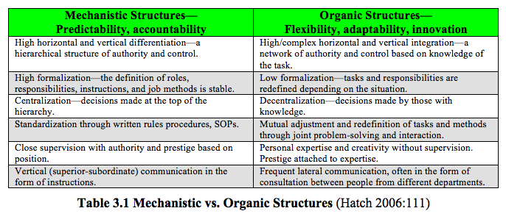
Types of Organizational Structures

Slide 7
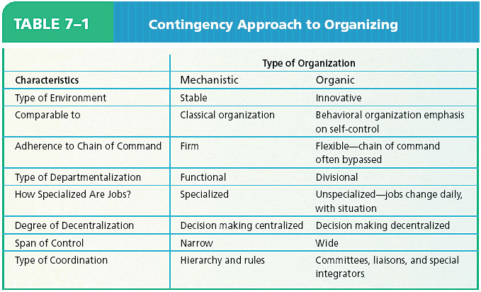

Slide 8
Volatile
Market
Stable
Market dominated Mix
Organic
Technology dominated Mix
Mechanistic
Stable
Technology Volatile
Environment Structure Relationships

Slide 9
Structure
‘Appropriate’
Competitive Advantage
People
‘Motivated’
Culture
‘Winning’
Components of an Organization and Its Competitive Advantage

Slide 10
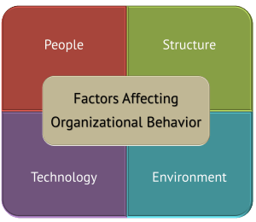
https://iedunote.com/forces-affecting-organizational-behavior

Slide 11
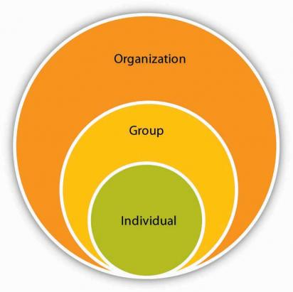
Level of Analysis

Slide 12
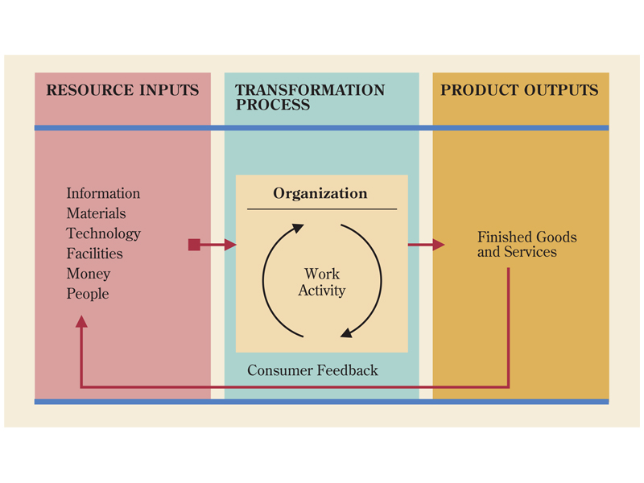
What are organizations like as work settings?

Slide 13
Case Study
Case 1: Mr. Aditya | Case 2: Mr. Swapnil
College Graduate | College Graduate (was in Mr. Aditya’s graduating batch)
Hired at Trekkie Technology | The Force Technology, a direct competitor of Trekkie Tech
Both are equally good in terms of Technical Skills and have great zeal and Motivation to work
Colleagues: Raju is a pompous jerk, Sonal is a constant complainer, Raja spends more time gossiping than working and Aditya’s boss, Mr. Rawat, is never around when Aditya needs him. | For Swapnil it is a great place to work because his coworkers and manager are supportive and work together to help each other succeed. His manager, Mr. Srivastava, considers himself a part of the team and even shares the same workspace.
Emotional Plight: Instead of focusing on his job, he spends much of his workday distracted, trying to keep his emotions in check so that he does not tell his coworkers what he really thinks of them | Swapnil is able to focus on his work and ask questions when needed and is highly productive as a result.
Behavioral response: He avoids these people at all costs, which is relatively easy due to his coworkers' preoccupations with themselves and others keeping them away from their desks | Swapnil loves his job, especially because of the people he works with.

Slide 14
What makes Swapnil and Aditya different?
What will happen to your behavior if you know that you are being videotaped and it will be posted on YouTube ?
Social Context and Organizational Behaviour

Slide 15
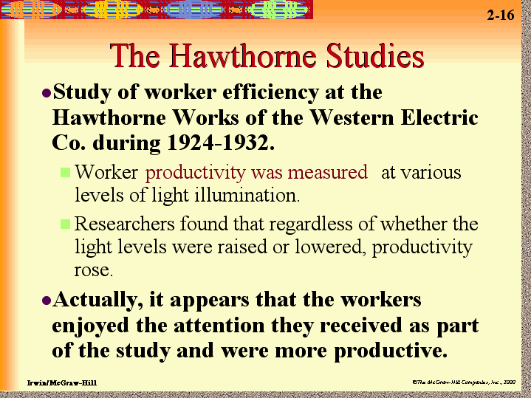

Slide 16
HAWTHORNE EXPERIMENT
Conducted between 1924-1932
Conducted at WESTERN ELECTRIC COMPANY, Chicago, USA
Conducted by,
Elton Mayo
White Head
Roethlisberger

Slide 17
Experiments Conducted
Illumination Experiment
Relay Assembly Test Experiments
Relay Assembly Room #2
Mica Splitting Test Group
Plant Interview Group
Bank Wiring Observation Group

Slide 18
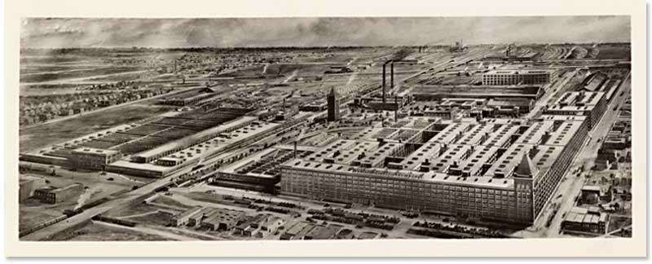
Aireal View of Hawthorne Works

Slide 19
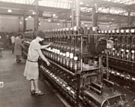
Magnetic Wire Insulating Department

Slide 20
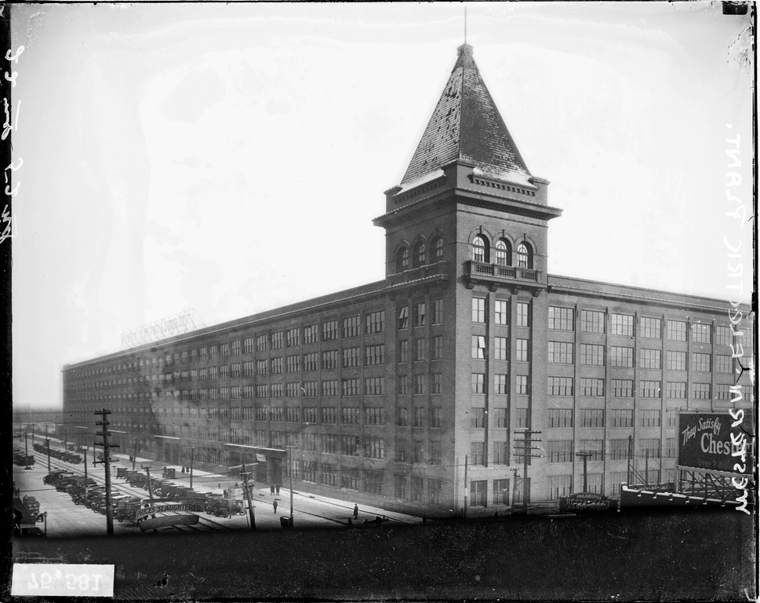
Western Electric Company

Slide 21
The experimenters concluded that it was not the changes in physical conditions that were affecting the workers' productivity. Rather, it was the fact that someone was actually concerned about their workplace, and the opportunities this gave them to discuss changes before they took place.

Slide 22
The Hawthorne Studies
Human Relations Implications
Hawthorne effect — workers’ attitudes toward their managers affect the level of workers’ performance

Slide 23
The Hawthorne Studies
Human relations movement – advocates that supervisors be behaviorally trained to manage subordinates in ways that elicit their cooperation and increase their productivity

Slide 24
The Hawthorne Studies
Implications
Behavior of managers and workers in the work setting is as important in explaining the level of performance as the technical aspects of the task
Demonstrated the importance of understanding how the feelings, thoughts, and behavior of work-group members and managers affect performance

Slide 25
Hawthorne Study and HCI
The area of concern [of HCI] is much broader than the simple “fit” between people and technology to improve productivity (as in the classic human factors mold); it encompasses a much more challenging territory that includes the goals and activities of people, their values, and the tools and environments that help shape their everyday lives .

Slide 26
Professional
A person who is expert at his/ her work
Respect for Self and Others
Trustworthy
Competent
Respectful
Act with Integrity
Considerate
Empathetic
Courteous
Dependable
Co-operative
Committed

Slide 27
How Professionals are Judged?
Largely by Unwritten rules
Attitudes
Conflict
Approaches
Values
Communication Styles

Slide 28
Job vs. Carrier
A job is: • A regular activity performed in exchange for payment. • A position in which one is currently employed.
A career is: • A chosen pursuit; a profession or occupation. • The general course or progression of one's working life or one's professional
achievements over time
Bottom line: Your job is what you are doing today. Your career is what you’ve done
over the past years and what you plan to do in the future

Slide 29
“Career”: I have to think long-term.
And when I think long-term, I begin to realize the following:
• Everything I do counts • Everything I do needs to have a good reason behind it • I have to make good decisions • Always think “What’s my next step?” • What I do today determines my tomorrow • Mistakes can potentially haunt me for a long time
One should pay serious attention to this “career” thing. Your job feeds you and your family today. Your career will feed you and your family tomorrow and beyond.

Slide 30
Professional
A person who is expert at his or her work.
Respect for Self and Others
Trustworthy
Competent
Respectful
Act with Integrity
Considerate
Empathetic
Courteous
Dependable
Co-operative
Committed

Slide 31
How Professionals are Judged
Largely by Unwritten rules
Attitudes
Conflict
Approaches
Values
Communication Styles

Slide 32
What Managers Do?
They get things done through other people.
Management Activities:
Make decisions
Allocate resources
Direct activities of others to attain goals

Slide 33
Managers vs. Leaders
Major Differences (Vineet Nayer, HBR, 2013)
Counting value vs Creating value
Circles of power vs Circles of influence
Managing work vs Leading people
Dealing with complexity vs Dealing with uncertainty
Doing things right vs doing right things
Maintaining vs Developing

Slide 34
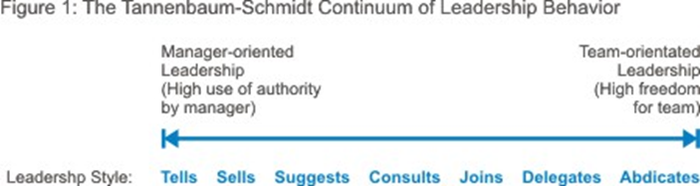

Slide 36
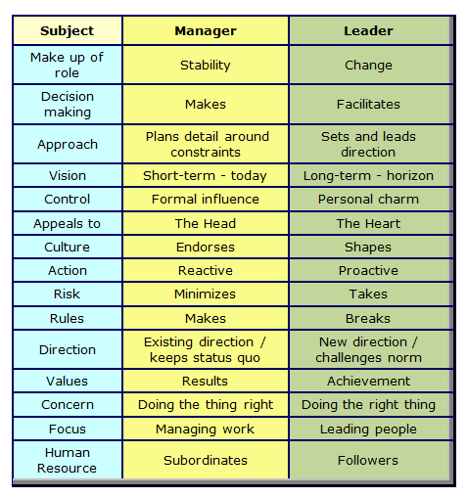

Slide 37
Organizational Behavior in a Global Context
Group Discussion (August 21, 2019)
Think Globally and Act Locally

Slide 38
Challenges and Opportunities for OB
Responding to Globalization
Managing Workforce Diversity
Improving Quality and Productivity
Improving Customer Service
Improving People Skills
Stimulating Innovation and Change
Coping with “Temporariness”
Working in Networked Organizations
Helping Employees Balance Work-Life Conflicts
Creating a Positive Work Environment
Improving Ethical Behavior

Slide 39
Responding to Globalization
Increased foreign assignments
Working with people from different cultures
Coping with anti-capitalism backlash
Overseeing movement of jobs to countries with low-cost labor
Managing people during the war on terror

Slide 40
Global vs Local

Slide 41
A case study of Cadbury’s marketing strategy
Cadbury, formerly Cadbury's, is a British multinational confectionery company wholly owned by Mondelez International since 2010. It is the second-largest confectionery brand in the world after Wrigley.

Slide 42
Ted Talk The Myths of Globalization: Peter Alfandary
Is globalisation about sharing a global culture, or designing new cultural borders?
Is cross-cultural awareness a new skill, a differentiated form of collective intelligence we should learn, and teach?
French educated, Italian speaking, English lawyer, Peter Alfandary describes himself as a mildly schizophrenic Brit. After 30 years practicing as an international lawyer, Peter decided to turn his lifelong fascination with different cultures into a full-time occupation – training and coaching professionals and senior executives on cross cultural management skills. He passionately believes that the need for cultural intelligence is increasingly critical as we move inexorably towards greater globalisation.Film and jazz buff, avid reader, Peter travels the world advising businesses and lecturing on cross cultural skills.

Slide 43
Global platform strategy
The global challenge
Global market size: standardization
Local differentiation: customization
Strategy: Determine best combination of global and local activities for competitive advantage

Slide 44
Structure
‘Appropriate’
Competitive Advantage
People
‘Motivated’
Culture
‘Winning’
Components of an Organization and Its Competitive Advantage

Slide 45
Managing Workforce Diversity
The people in organizations are becoming more heterogeneous demographically
Embracing diversity
Changing U.S. demographics
Changing management philosophy
Recognizing and responding to differences
Disability
Gender
Age
National Origin
Non-Christian
Race
Domestic Partners

Slide 46
Forces of Globalization
Globalization – The trend toward a unified global economy involving free trade and a free flow of capital between countries
Products, services, people, technologies, and financial capital move relatively freely across national borders
Tariffs, currency laws, travel restrictions, immigration restrictions, and other barriers to these international flows become less difficult to manage
Unified world market in which to sell products and services, and acquire resources

